Slide 1


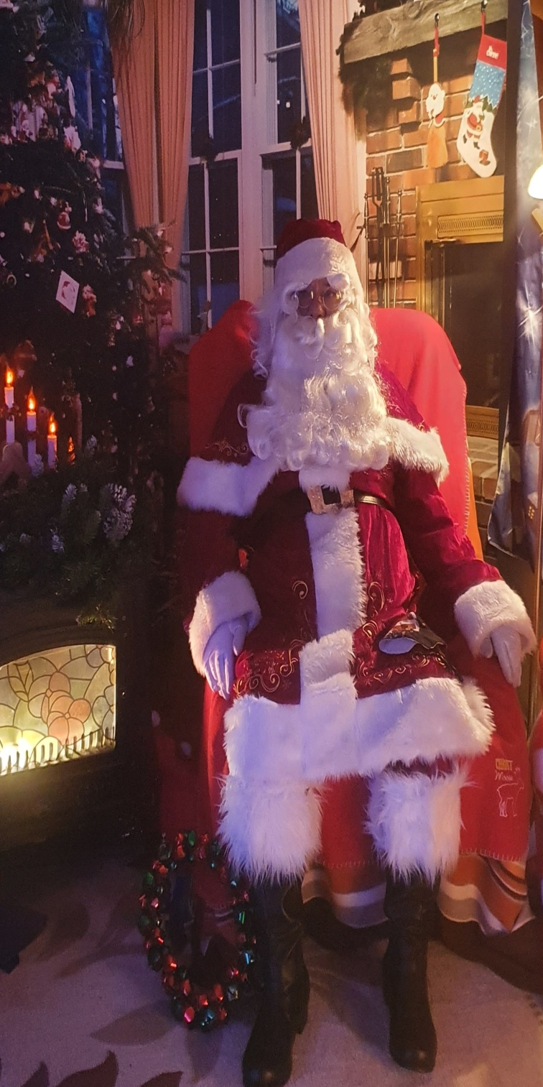
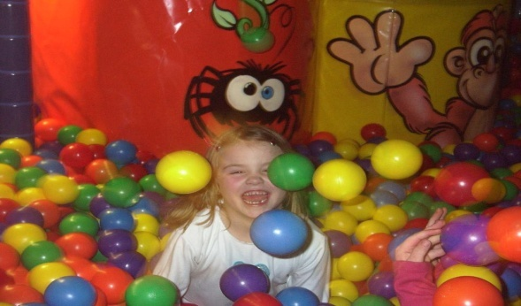
Visit Santa at
SANTA
WILL BE HERE IN HIS SANTA HUT
Saturday 7th 1-6pm
Sunday 8th 1-6pm
Saturday 14th 1-6pm
Sunday 15th 2-6pm
Saturday 21st 1-6pm
Sunday 22nd 1-6pm
€16 PER CHILD
includes
PRESENT & SWEETS &
€5 VOUCHER FOR NOKEYS ADVENTURELAND
Instant Photo €3
BOOKINGS ON www.mayoleisurepoint.ie/visit-santa/

